Slide 1

Telecom Churn Case Study
By,
Krishna Prasad Ponnur,
Kowshik Sarma,
Koripadu Lavanya
Notes:
Line spacing + Page numbers

Slide 2
Agenda
01 Business Problem Statement
02 Steps Involved
03 Data cleaning
03 EDA
Univariate Analysis
Bivariate Analysis
Multivariate Analysis
04 Class Imbalance
05 Model Selection
06 Model Building
07 Model Evaluation
08 Important Indicators
09 Insights

Slide 3
Business Problem Statement
In the telecom industry, highly competitive market, the telecommunications industry experiences an average of 15-25% annual churn rate. Given the fact that it costs 5-10 times more to acquire a new customer than to retain an existing one, customer retention has now become even more important than customer acquisition.
To reduce customer churn, telecom companies need to predict which customers are at high risk of churn.
Approximately 80% of revenue comes from the top 20% of customers (called high-value customers). Thus, if we can reduce the churn of high-value customers, we will be able to reduce significant revenue leakage.
Retaining high profitable customers is the number one business goal.

Slide 4

Steps Involved
Missing value imputation
Exploratory Data Analysis
Model Selection :
To find the best model that could forecast consumer behavior, extensive experimentation with a larger number of models was conducted. This allowed the business to take proactive measures to keep the clients.
Models tried to give the best are:
Logistic regression with RFE and manual elimination,
Decision tree,
Random forests
with Random under-sampling, TOMEK Links, Random over-sampling, SMOTE, ADASYN and SMOTE+TOMEK.
Model Building
Model Evaluation
Insights

Slide 5
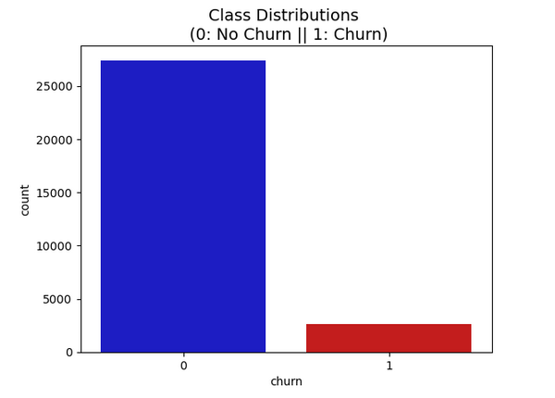
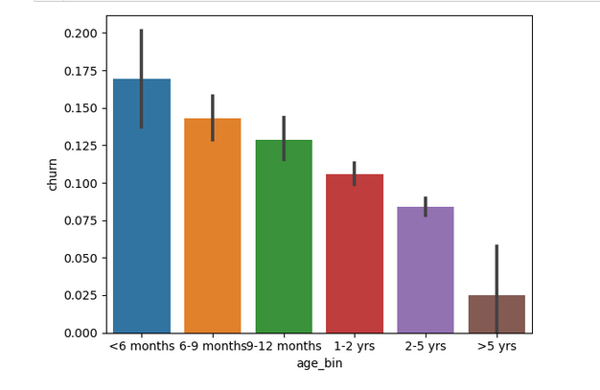
Exploratory Data Analysis
- Univariate Analysis
There is high class imbalance and , it has been handled.
Churn
The churn rate rises in comparison to new consumers. After utilizing the network for a while, users are generally satisfied.
aon_month

Slide 6
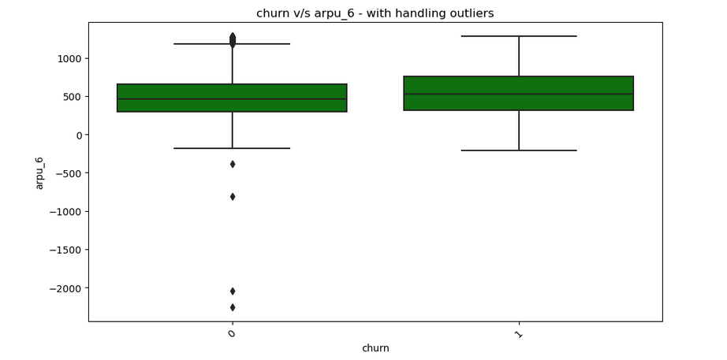
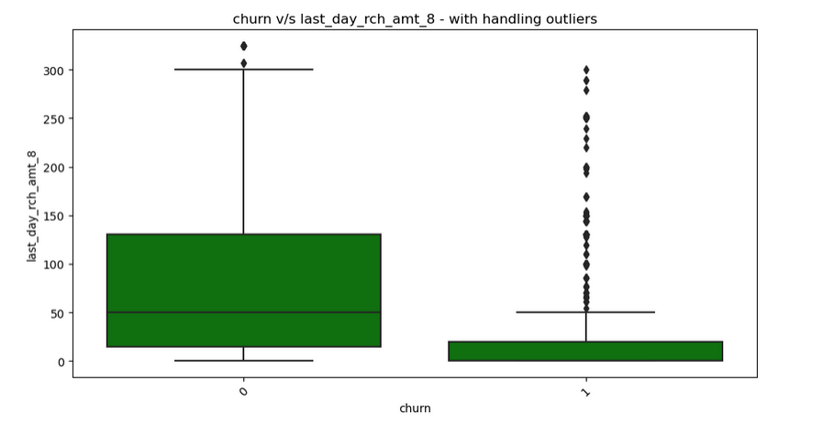
Exploratory Data Analysis
- Bivariate Analysis
The Minimum average revenue per user (ARPU) lies between 250 to 500.
ARPU_6
The median last day recharge amount for month 8, during the action phase, is almost zero, indicating that churned customers did not recharge at the end of this month. Consequently, it's apparent that their purchasing activity significantly decreases in month 8, which precedes their churn in month 9.
last_day_rch_amt_8

Slide 7
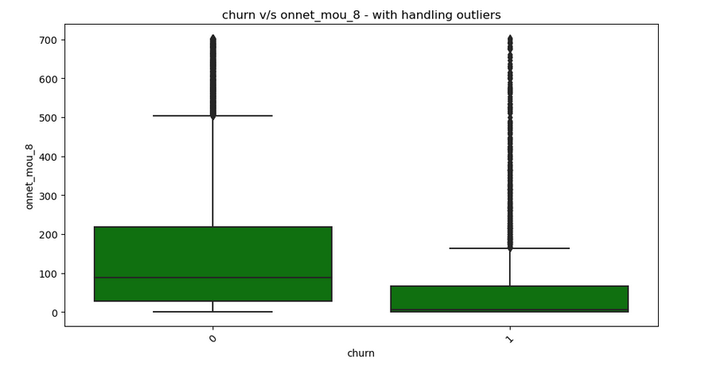
Exploratory Data Analysis
- Bivariate Analysis
onnet_mou_8
The median on-network minutes of usage for month 8, which corresponds to the action phase, is significantly lower for churned customers when compared to non-churned customers. This observation strongly indicates a decreasing pattern in their network usage leading up to their churn.

Slide 8
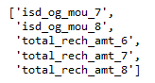
Exploratory Data Analysis
- Correlation Analysis
As the data set contains numerous variables, its difficult to deduce a heat map for all. So, we have checked correlation matrix for all variables and derived these highly correlated variables. Eliminated these highly correlated variables.
Correlated variables

Slide 9

Class Imbalance Handling
Class imbalance can significantly impact model performance. To address this issue, several techniques, including under sampling, oversampling, SMOTE (Synthetic Minority Over-sampling Technique), Tomek links , ADASYN and SMOTE+TOMEK have been employed in our model.
The above-mentioned techniques are performed on Logistic Regression , Decision tree and Random forest Models.

Slide 10
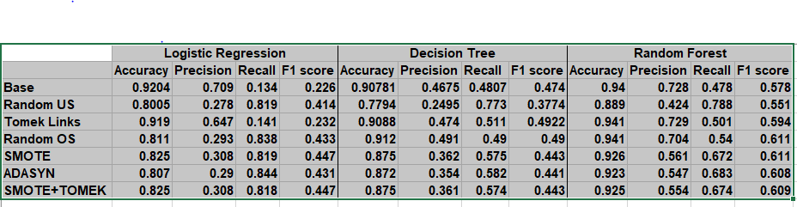
Model Selection
Both Logistic Regression and Random Forest have high Accuracy, Precision, Recall, and F1 scores for the SMOTE. Using RFE and manual exclusion, we will construct a logistic model on the SMOTE resampling.

Slide 11
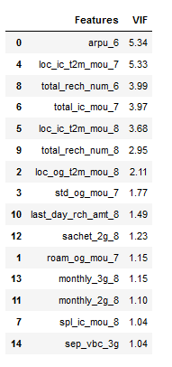
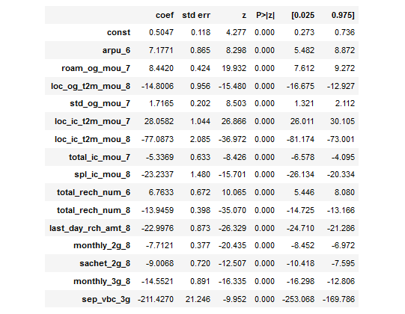
Model 1 , 2 & 3 on Logistic Regression
For Model – 3 , the p-value is ‘zero’ for all the variables and the VIF value is low. Based on these, Model – 3 is selected for model evaluation.

Slide 12
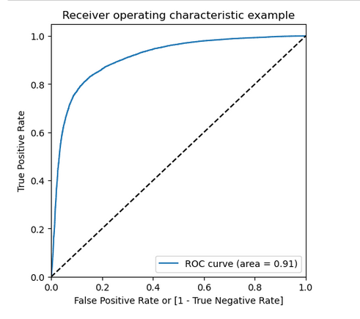
Logistic Regression - Model Evaluation on Train set
The ROC of the model is 91% which shows a strong performance.
ROC curve

Slide 13
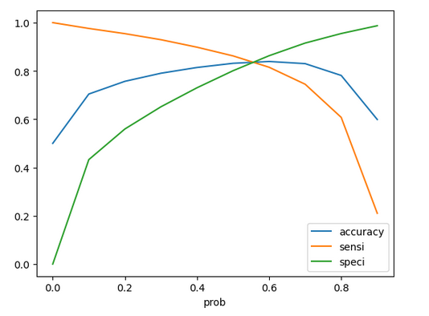
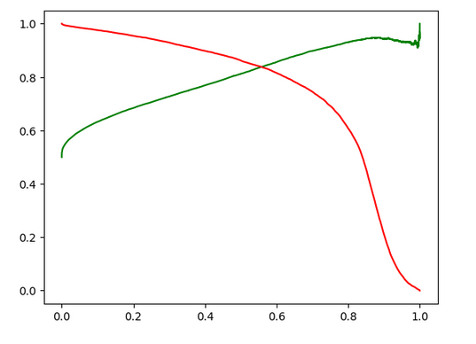
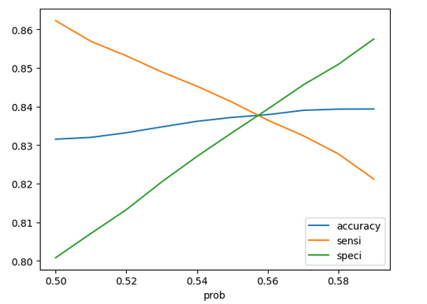
Logistic Regression - Model Building on Train set
Accuracy , Sensitivity and Specificity for various probability cutoffs
The probability lies between 0.5 and 0.6
Probability cutoff
Precision , Recall curve
The probability selected is 0.54
Intersection threshold point is 0.54
Probability cutoff between 0.5 and 0.6

Slide 14
Hyper-parameter Tuning In Random forest
As the Model – “Linear Regression” shows greater results than Random forest, we are going to consider that model for Model evaluation.
Hyper-parameters like :
'max_depth’
'max_features’
'min_samples_leaf’
'n_estimators’ are used.
And got a ‘best_score’ result as 94.2
And max_depth=15, max_features=3, min_samples_leaf=20, n_estimators=80

Slide 15
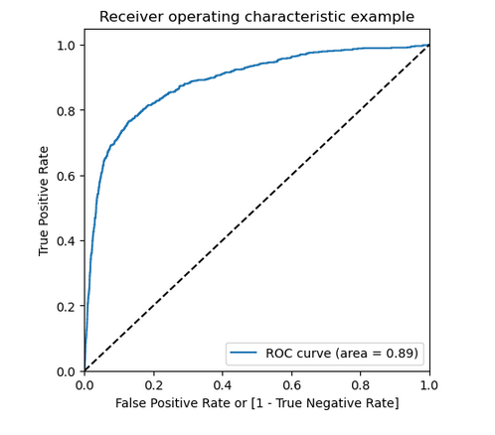
Logistic Regression - Model Evaluation on Test set
The ROC of the model is 89% which shows a strong performance.
ROC curve

Slide 16
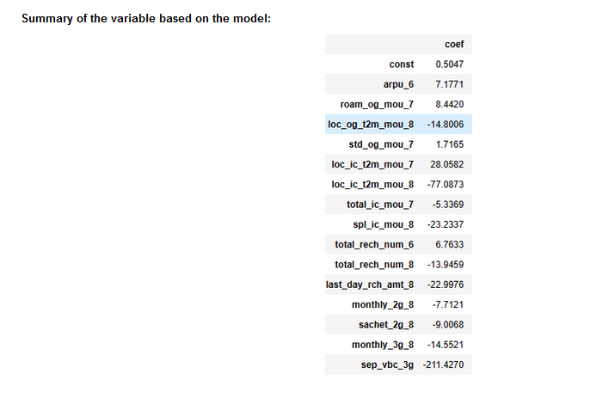

Important indicators:
1.Average revenue per use for month 6
2.ROAM outgoing calls minutes of usage for month 7
3.Local outgoing (Operator T to other operator) calls minutes of usage for month 8
4.STD outgoing calls minutes of usage for month 7
5. Local incoming calls minutes of usage for month 7 , 8
6.Total incoming calls minutes of usage for month 7
7. Special incoming calls minutes of usage for month 8
8.Total number of recharges for the month of 6 , 8
9.Last day recharge amount for month 8
10.Mobile internet recharge for 2G in month 8
11. Sachet internet recharge for 2G in month 8
12.Mobile internet recharge for 3G in month 8
13.Volume based cost for September (month 8)

Slide 17
Insights
In the context of this telecom company, the primary focus is on identifying churners rather than non-churners. Customer retention takes precedence as the most critical objective. Therefore, we will select Sensitivity/Recall as our evaluation metric since it quantifies the proportion of actual positives correctly detected.
Take note of the following essential predictor attributes, which serve as indicators of churn:
1. The most important consumers who are prone to churn are those who have just begun utilizing the telecom network. Customers who have been utilizing the network for a longer period are content with it.
2. The count of recharges, the recharge amount, and the last recharge date are crucial indicators of customer usage. A decrease in any of these metrics may suggest that the customer intends to wait until the remaining validity period before considering a switch to another provider. Offering discounted recharge packs during this time could help retain the customer.
3.Internet usage is a vital variable as it signifies whether a customer is actively engaged in mobile operations like social networking, mobile banking, and bill payments. A decrease in or complete cessation of internet usage may signal a higher likelihood of churn. To retain such customers, attractive offers like bundled data packs, reduced prices, or even a month of free data can be provided to incentivize them to remain on the network.
4. Our focus should be on, and efforts should be made to retain the clients whose average monthly revenue for the month of June is quite high.
5. Customers that have made extremely few special calls, used very little internet use, recharged very little internet, and have used very few minutes for local outbound calls throughout the month of August likely to churn.
6.It is essential to consistently monitor incoming STD (Standard), roaming outgoing, incoming calls and Special calls for Month 7 to detect any discernible decline in usage patterns.
7.By examining the cost based on volume for the 9th month, we can assess whether the customer is demonstrating a commitment to remain on the network into Month 9.

